Slide 1

Creating Dashboards with Potly and Dash

Slide 2
Objectives
Identify high-level popular Python dashboarding tools.
Demonstrate basic Plotly, Plotly.graph_objects, and Plotly express commands.
Demonstrate using Dash and basic Dash components (core and HTML).

Slide 3
Dashboarding Overview
Why Dashboard?
  Real time visuals
  Understand business moving parts
  Visually track, analyze, and display key performance indicators (KPI)
  Take informed decisions and improve performance
  Reduce hours of analyzing
Best dashboard answers important business questions

Slide 4
Dashboarding Overview
Scenario: monitor and report US airline performance
Report requested:
  The top 10 airline carrier in the year 2019 in terms of number of flights
  The number of flights in 2019 split by month
  The number of travelers from California state to other states split by distance group
Student give the solutions!

Slide 5
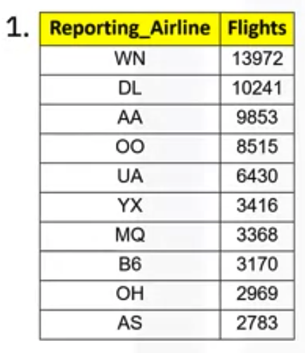
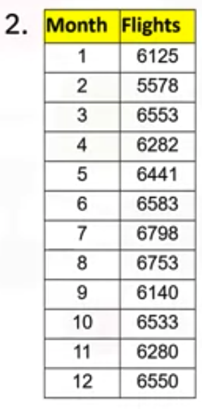
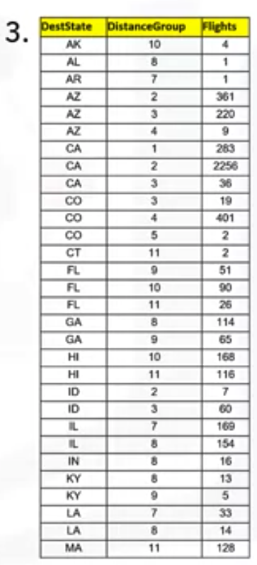
Dashboarding Overview
Answer without dashboard

Slide 6
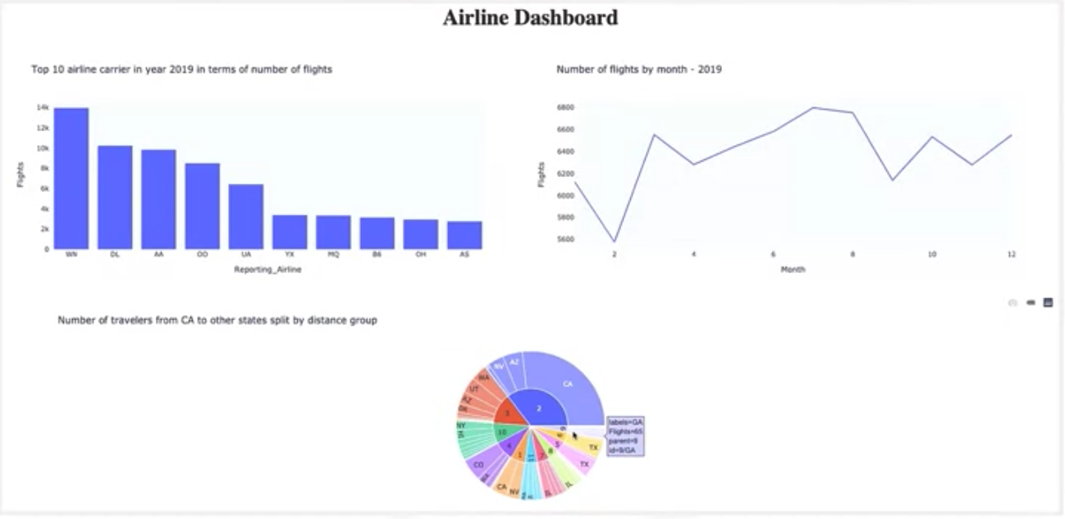
Dashboarding Overview
Answer with dashboard
What is your choice?

Slide 7
Introduction to Plotly
Plotly is an interactive, open source plotting library that supports over 40 unique chart types.
It is available in Python, R and Javascript.
Plotly python is build on top of Plotly Javascript library and includes chart types like statistical, financial, maps, scientific, and 3-dimensional data .
The web based visualizations created using Plotly python can be displayed in Jupyter notebook, saved to standalone HTML files, or served as part of pure Python-built web applications using Dash.

Slide 8
Introduction to Plotly
Plotly sub-modules:
  Plotly graph objects: low- level interface to figures, traces, and layout
  plotly.graph_objects.Figure
  Plotly express: high level wrapper: creating most common figures

Slide 9
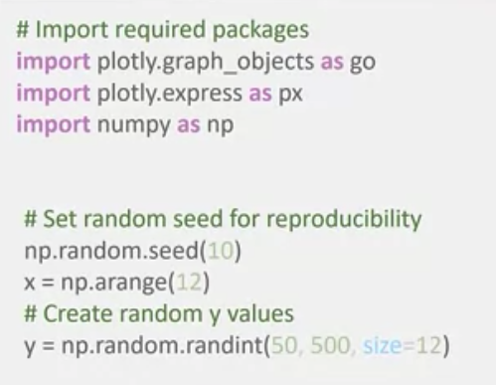
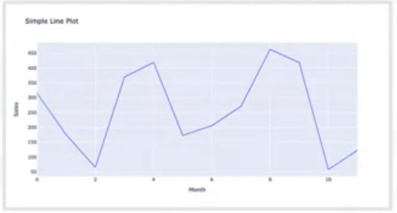
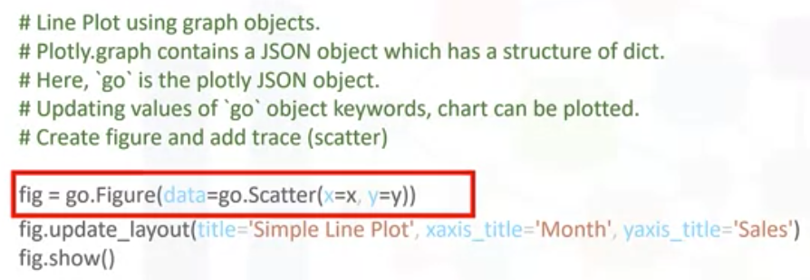
Introduction to Plotly
Try this code and show the results: using plotly.graph_object

Slide 10
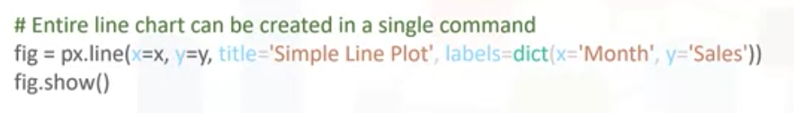
Introduction to Plotly
Try this code and show the results: using plotly.express

Slide 11
Summary
Identify high-level popular Python dashboarding tools.
Demonstrate basic Plotly, Plotly.graph_objects, and Plotly express commands.
Demonstrate using Dash and basic Dash components (core and HTML).

Slide 12
Q & A

